Slide 1

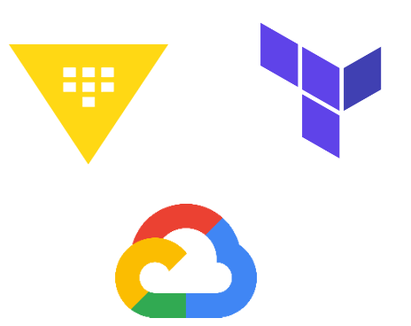
Dynamic Credentials with HashiCorp Vault and GCP Provider + Terraform
Dynamic and Secure Management of Secrets with Automation for GCP and Terraform
Presented by: Fredrick Sachita A.
Notes:
Welcome. Managing GCP infrastructure with Terraform can be efficient, but security risks arise from embedded long-lived credentials.
This presentation we will explore how Vault's dynamic credentials address this challenge, providing both enhanced security and granular control.

Slide 2

Agenda
HashiCorp Vault
GCP Secrets Engine in Vault
Terraform Integration
Demo: Dynamic Credential Generation + Terraform
Best Practices + Q&A

Slide 3
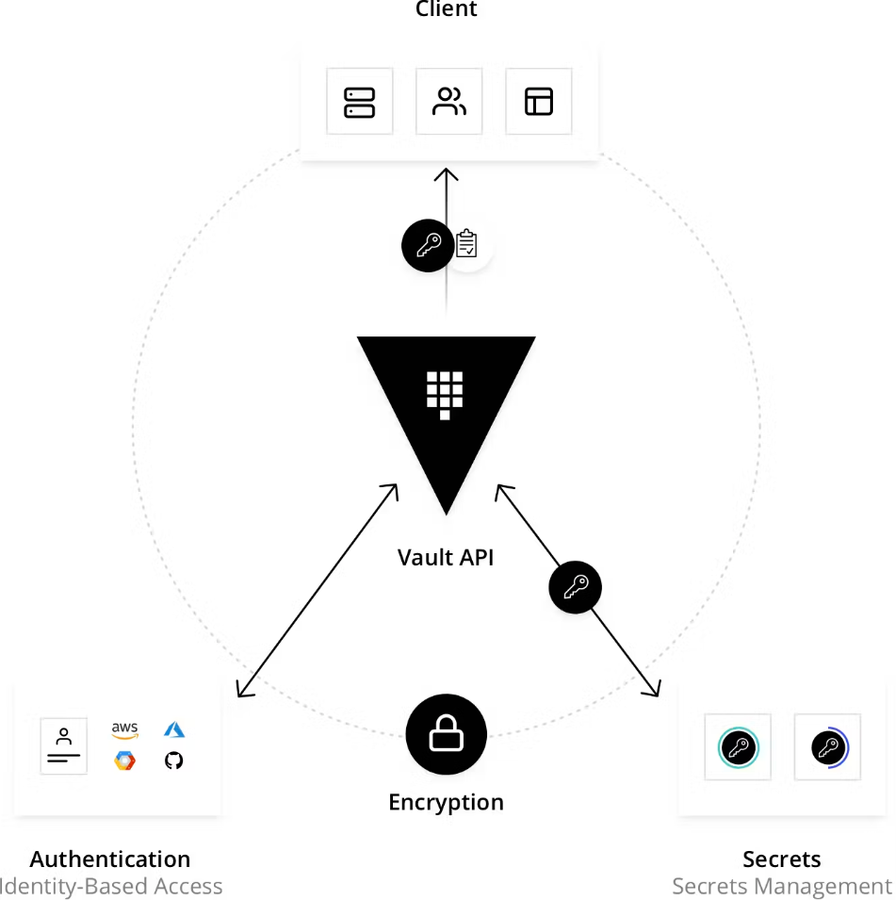
Vault
Vault is an identity-based secrets and encryption management system. A HashiCorp tool that helps organizations to manage and transmit secrets(API encryption keys, passwords, and certificates) safely in different environments and applications.
It provides encryption services that are gated by authentication and authorization methods to ensure secure, auditable and restricted access to secrets.
Using Vault’s UI, CLI, HTTP or API access to secrets and other sensitive data can be securely stored and managed, tightly controlled (restricted), and auditable.
Vault validates and authorizes clients (users, machines, apps) before providing them access to secrets or stored sensitive data in hybrid cloud environments
API-driven.
Vault is used to generate dynamic short lived credentials or encrypt application data on the fly
Why vault?
You can fine-tune access control by assigning specific IAM roles and policies to each set of credentials.
Vault acts as a central store, eliminating manual credential management and rotation.
Notes:
In today's modern Infrastructure, Developer and DevOps practices, managing secrets is a crucial task. However, it can be challenging to secure sensitive information across different environments, configurations and organizations.
Static credentials make enforcing least privilege access control challenging.
Manually rotating and managing credentials across environments is cumbersome and error-prone.
A breach can expose/compromise access to all associated GCP resources and data leading to financial losses, reputational damage, legal troubles, regulatory fines, and a profound erosion of consumer trust.
Vault's dynamic credentials offer a secure and efficient solution.
Key Vault features;
Security Centralization
Dynamic secrets
Key management
Identity based authentication
Uniformity and standardization
Data encryption
Vault has two modes:
Dev mode- for development and experimentation, runs in-memory and starts unsealed.
Prod mode-has integrated storage that allows data to persist on container restart.

Slide 4
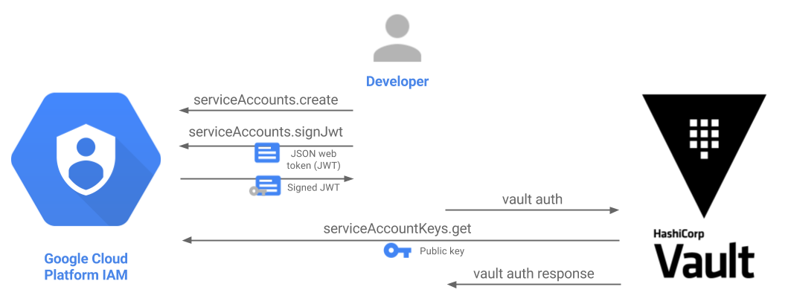
GCP Secrets Engine in Vault
Google Cloud Vault secrets engine dynamically generates Google Cloud service account keys and OAuth tokens based on IAM policies.
On Google Cloud Platform (GCP), you can manage services or temporary users using Cloud Identity and Access Management (IAM) service accounts, which are identities whose credentials your application code can use to access other GCP services.
You can access a service account from code running on GCP, in your on-premises environment, or even another cloud.
Vault can generate two types of credentials for GCP with a time-to-live (TTL) enforcing its validity so that the credentials are automatically revoked when they are no longer used:
JSON formatted service account key credential file
OAuth token
Notes:
The GCP Provider is a plugin for HashiCorp Vault that enables you to generate short-lived credentials for Google Cloud services. With the GCP Provider, you can create dynamic secrets that are automatically revoked after a specified time. This ensures that your secrets remain secure and do not get compromised while automating infrastructure.
Setting up the integration involves three key steps: establishing trust, configuring the Terraform Cloud workspace, and utilizing dynamic credentials within Terraform code.
You have a Google Cloud Platform account with permission to:
Create IAM service accounts, policies
Enable GCP APIs
IAM API
Cloud Resource Manager API
Compute Engine API(resource specific API you need)
Access the GCP Cloud Shell
Create VMs

Slide 5
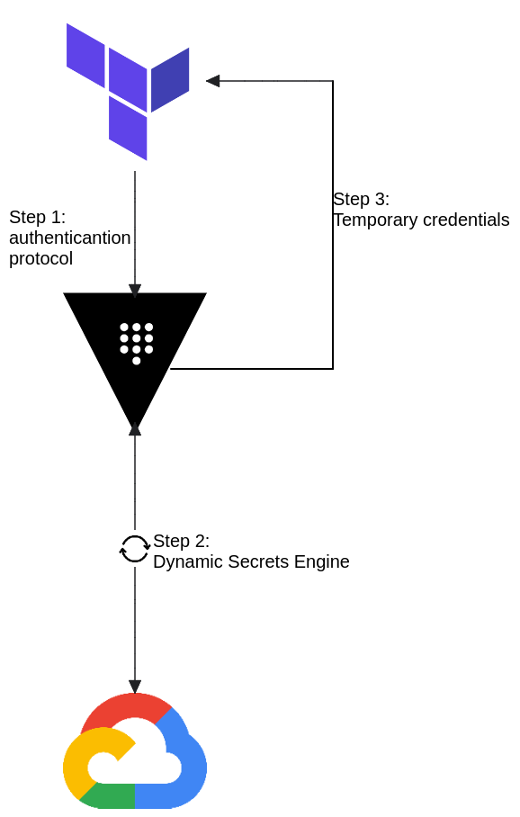
Terraform Integration
Infrastructure as Code (IaC) tools allow you to manage infrastructure with configuration files rather than through a graphical user interface. IaC allows you to build, change, and manage your infrastructure in a safe, consistent, and repeatable way by defining resource configurations that you can version, reuse, and share.
Terraform has several advantages over manually managing your infrastructure:
Terraform can manage infrastructure on multiple cloud platforms.
The human-readable configuration language helps you write infrastructure code quickly.
Terraform's state allows you to track resource changes throughout your deployments.
You can commit your configurations to version control to safely collaborate on infrastructure.
Notes:
Terraform is a tool for managing infrastructure as code (IaC). It is an open-source tool created by HashiCorp that uses a declarative programming language called Hashicorp Configuration Language (HCL) allowing users to define and manage infrastructure resources in human-readable configuration files.
Terraform streamlines infrastructure management, using static credentials within code presents security vulnerabilities.
Each Terraform run receives from vault unique, temporary credentials, reducing the impact of potential breaches.

Slide 6
Demo: Dynamic Credential Generation+ Terraform code
# Configure Vault provider with authentication and TTL
provider "vault" {
address = "https://vault.fredrickamutala.com" # Replace with actual Vault address
token = var.vault_token # Securely retrieve Vault token
}
# Fetch GCP credentials with TTL from Vault
data "vault_generic_secret" "gcp_creds" {
path = "gcp/creds/sachita" # Replace with the actual secret path
}
# Use dynamic credentials from Vault for authentication
provider "google" {
project = data.vault_generic_secret.gcp_creds.data["project_id"]
region = "us-east1"
credentials = data.vault_generic_secret.gcp_creds.data["credentials"]
}
#Create the GCE instance using dynamic credentials
provider "google" {
project = "engineering-sachita" #Replace with your project id
region = "us-east1" #GCP region
}
resource "google_compute_instance" "sach-gce" {
name = "sach-gce" #unique name for the instance
machine_type = "e2-micro"
zone = "us-east1-b" #GCP available zone in the chosen region
boot_disk {
initialize_params {
image = "ubuntu-os-cloud/ubuntu-2204-lts"
size = 10 #Disk size in GB
type = "pd-ssd" #Disk type
}
}
Notes:
Let's take a look at an example code block that shows how to use HashiCorp Vault, GCP Provider, and Terraform to generate short-lived credentials for Google Cloud services.
Dynamic credentials eliminate the need for static credentials in your Terraform code.
Define and explain the GCP provider block.

Slide 7
Best Practices and Q&A
Execute terraform programmatically: Use Terraform to provision cloud, private datacenter, and SaaS infrastructure.
Allow minimal write privileges: The unprivileged Vault service account should not have access to overwrite its executable binary or any Vault configuration files.
Automate the whole process: Use tools like GitLab CI/CD or Jenkins to automate the process of creating, testing, and deploying your Terraform modules.
Avoid storing secrets in state: Store your state file in secure remote storage like Blob in Azure, GCS(Google Cloud Storage) buckets in GCP, S3 in AWS etc.
Encrypt state: Encrypt application data both at rest and in transit.
Provider Design Principles: Providers should focus on a single API or problem domain.
Provisioning: Use collaborative infrastructure as code, using Terraform as the core workflow and Terraform Cloud to manage the boundaries between your organization's different teams, roles, applications, and deployment tiers.
Q&A
Notes:
Using HashiCorp Vault, GCP Provider, and Terraform, you can securely manage secrets and dynamically generate short-lived credentials for Google Cloud services. This ensures improved security posture, automation of secrets management, and enhanced collaboration in DevOps pipelines.
Thank you

